Slide 1

ADULT CENSUS INCOME
Data Mining
Group 1
AI17C
FPT University
Oct 29 2024

Slide 2
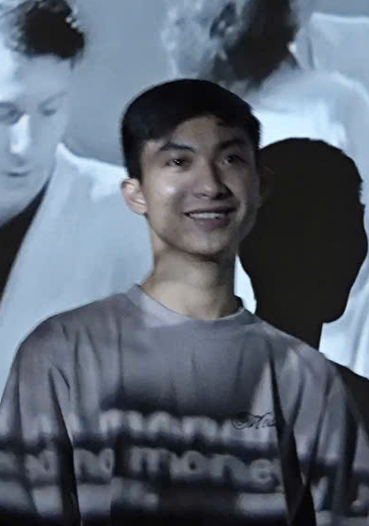

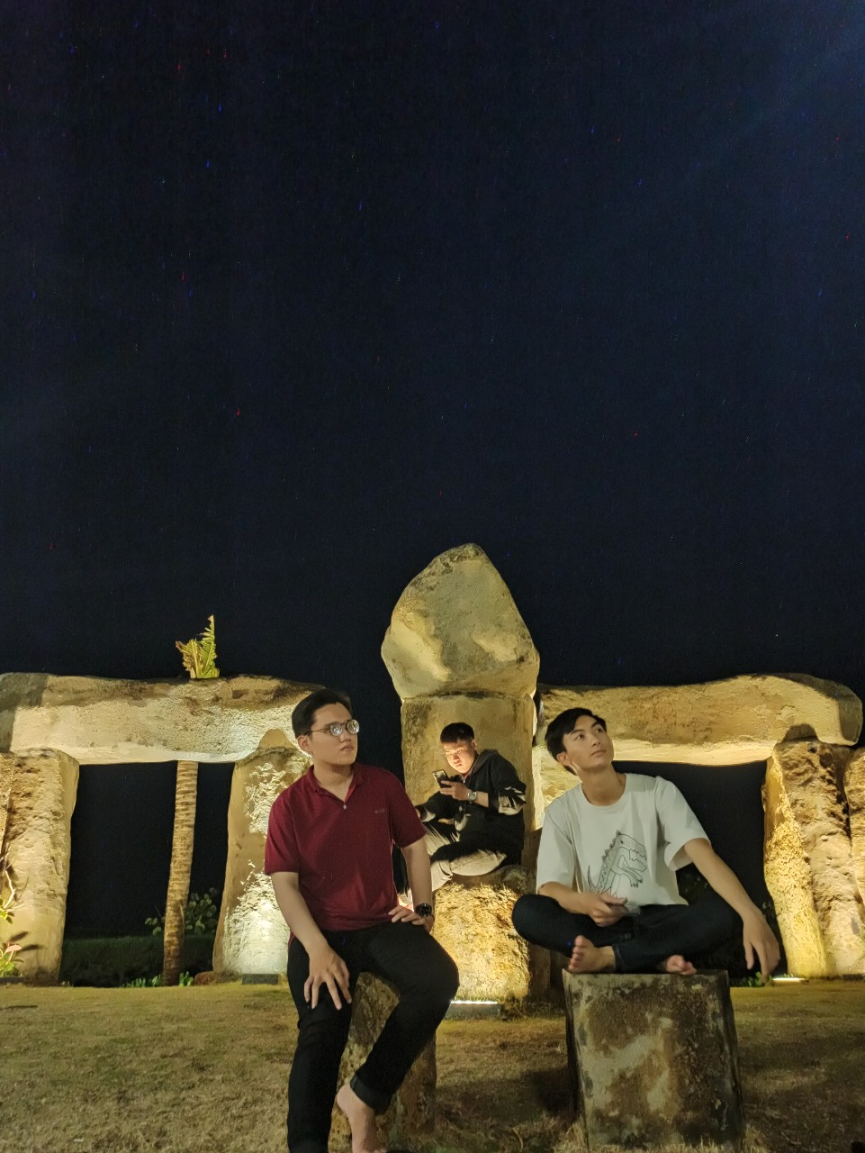
MEMBERS
Ha Khai Hoan
Nguyen Van Thu
Dang Phuc Bao Chau

Slide 3

CONTENT
I
PROJECT OVERVIEW
II
IMPLEMENTATION
III
CONCLUSION

Slide 4
I. PROJECT OVERVIEW

Slide 5
PROJECT OVERVIEW
1
PROBLEM
2
PLANNING
3
DATA OVERVIEW

Slide 6
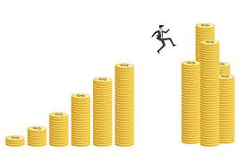
1 PROBLEM
Currently, currency transactions at banks are increasing. Including bank loans.
Banks need to clearly define the conditions for repayment to proceed with lending. In which, high or low income is an important deciding factor.
So what criteria does a person with a high income meet?
That is the issue we are focusing on researching.
Insurance
Advertising & Marketing
Income
Real Estate
Credit Analysis
Education
Customer Segmentation
…

Slide 7








2 PLANNING
W2
Search for solutions
W4
Report 1
W8
W10
W6
Conclusion for the hypothesis
Improve
Summary
W1
Create teams
and projects
W3
Data processing
W5
Hypothesis testing
W7
Report 2
W9
Report 3
Project complete

Slide 8
3 DATA OVERVIEW
We used the Adult Census Income dataset from Kaggle to predict individual income based on demographics.
Instead of training on the full dataset, we sampled from it to test our approach efficiently before scaling up to larger data.
Age | Individual's age
Workclass | Type of employment
fnlwgt | Weighting factor
Education | Highest education level achieved
Education-num | Years of education
Marital-status | Marital status
Occupation | Job type
Relationship | Family role
Race | Ethnic background
Sex | Gender
Capital-gain | Profit from asset sales
Capital-loss | Loss from asset sales
Hours-per-week | Weekly working hours
Native-country | Country of origin
Salary | Income bracket (>50K or <=50K)
Our data
Number of rows of data:
32561
Number of columns of data: 15
Test 1
Test
2
Test
3
Train
Method

Slide 9
II. IMPLEMENTATION

Slide 10
IMPLEMENTATION
1
DEFINE SOLUTION
2
ARCHITECTURE AND ASSIGN TASKS
3
MODEL - TRAINING - EVALUATION
4
OPTIMIZER
5
DEMONSTRATION

Slide 11
1 DEFINE SOLUTION
Missing handle
Logistic Regression
Outlier handle
Duplicate handle
Random Forest
Data preprocessing
Build model
K-Nearest Neighbors
Feature engineering
Categorical features
Numerical features

Slide 12
1 DEFINE SOLUTION

Slide 13
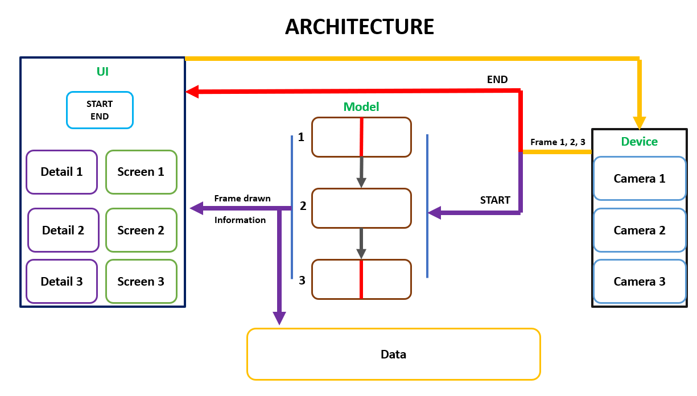
2 ARCHITECTURE AND ASSIGN TASKS
ARCHITECTURE

Slide 14
2 ARCHITECTURE AND ASSIGN TASKS
TASK
BOTTLE CHECK
BAO CHAU
LABEL CHECK
VAN THU
WATER CHECK
QUOC VUONG
AI
Master
Software
UI – KHAI HOAN
DATA PROCESSING - NGOC PHUC
Data

Slide 15
3 MODEL - TRAINING - EVALUATION
3.1
STAGE 1
a Data collection
b Model – Training - Evaluation
c Problems
3.2
STAGE 2
a Data collection
c Model – Training - Evaluation
c Problems

Slide 16
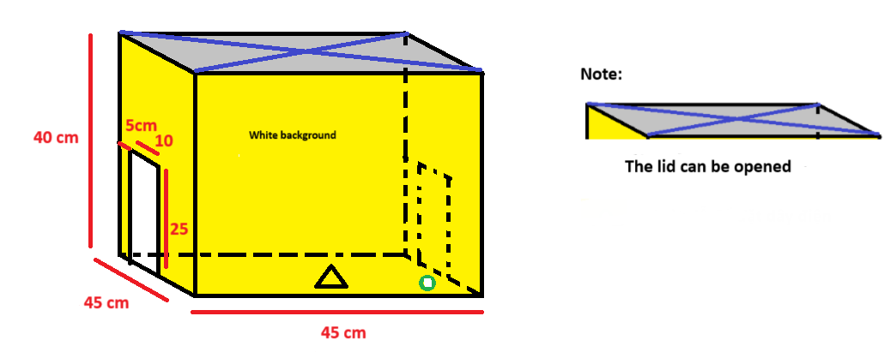

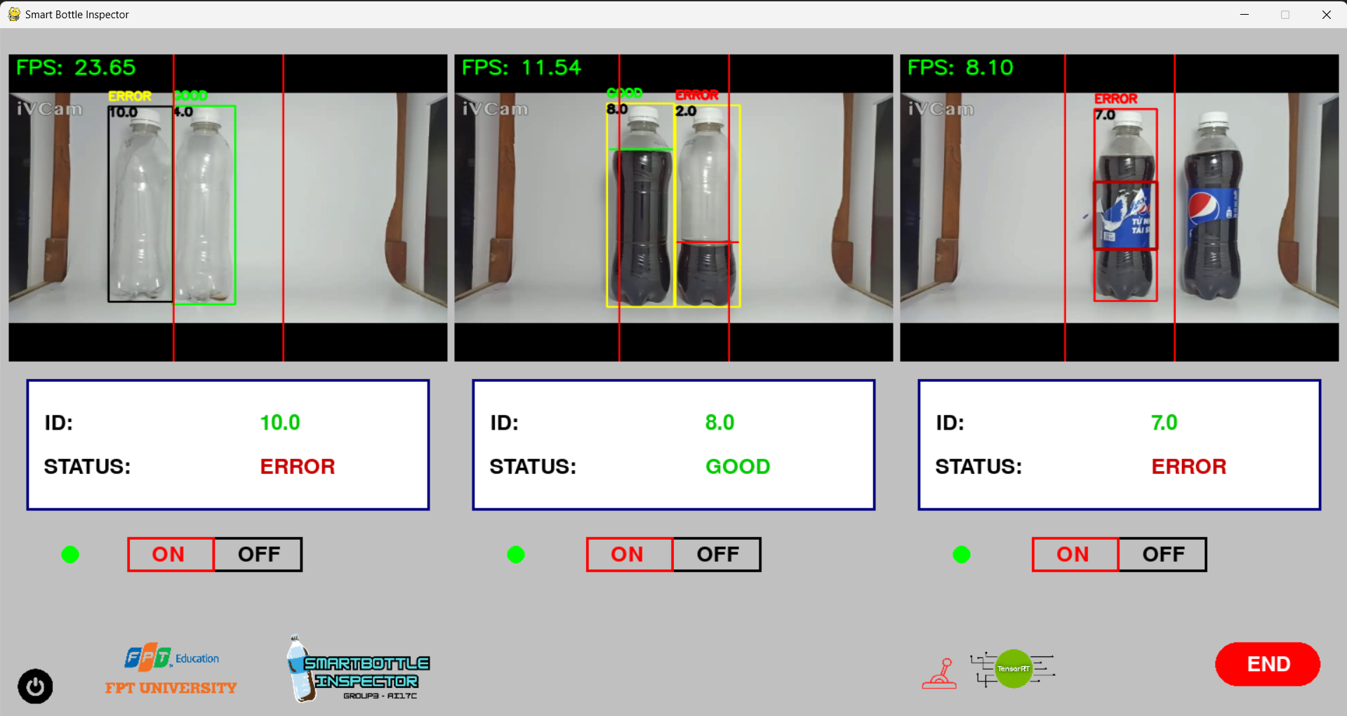
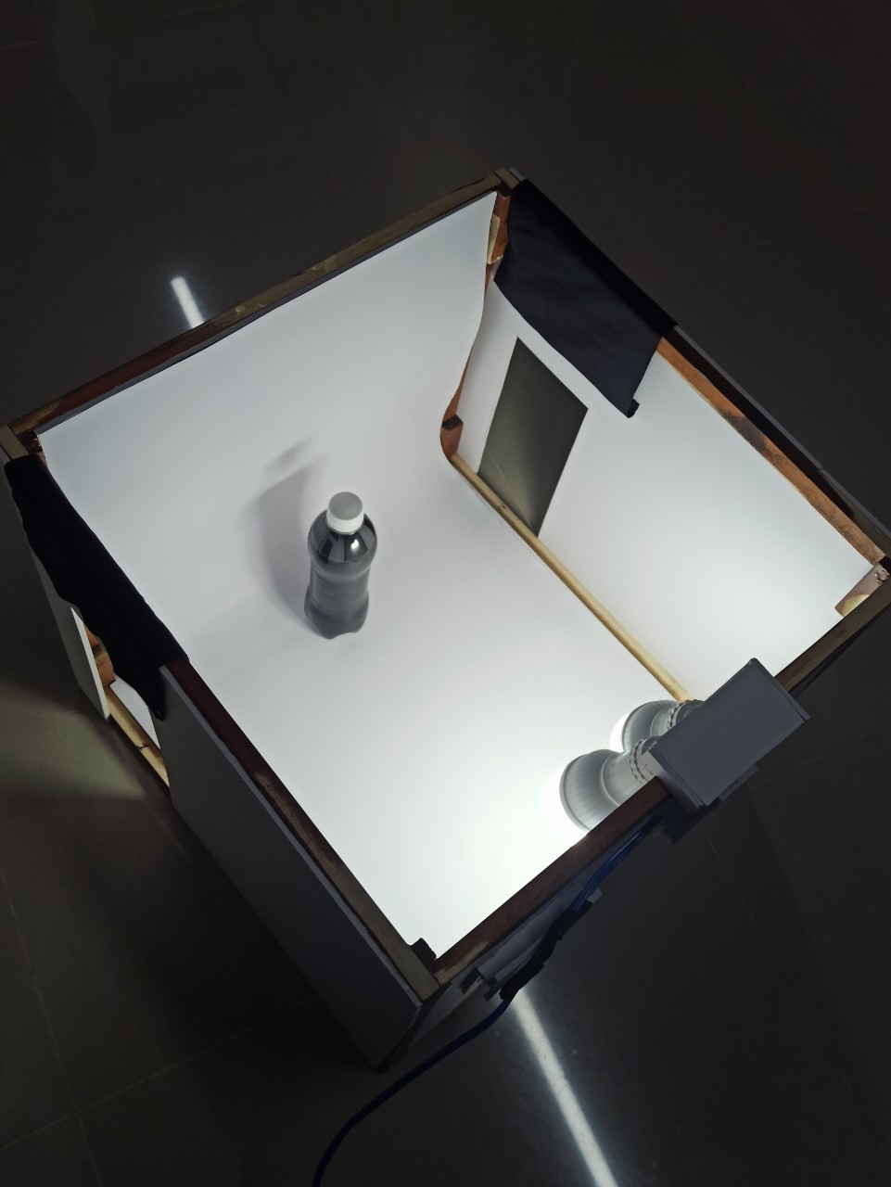
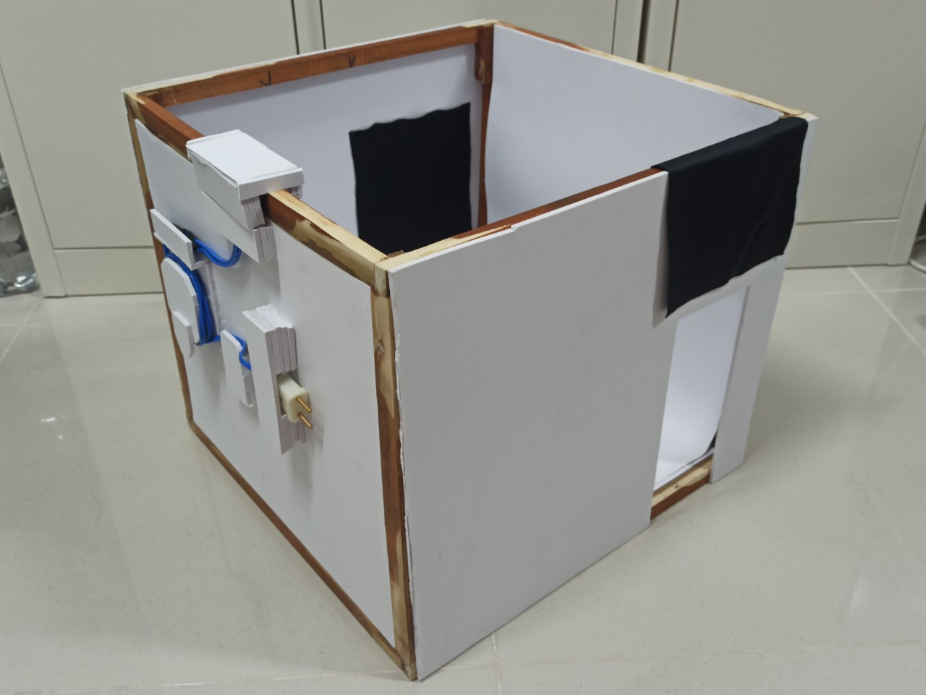
3.1.a DATA COLLECTION
STAGE 1
UI: Use Python’s Pygame library to build the interface for the product.
Keep the same hardware, which is used in product v1.0
Camera

Slide 17
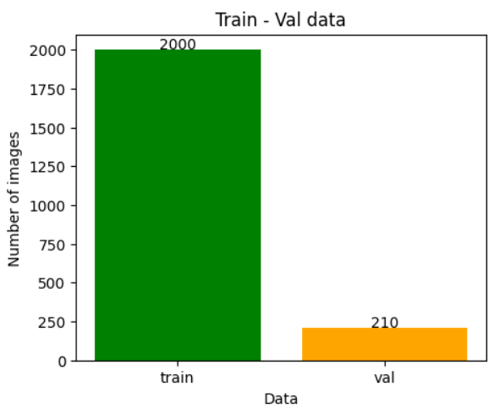
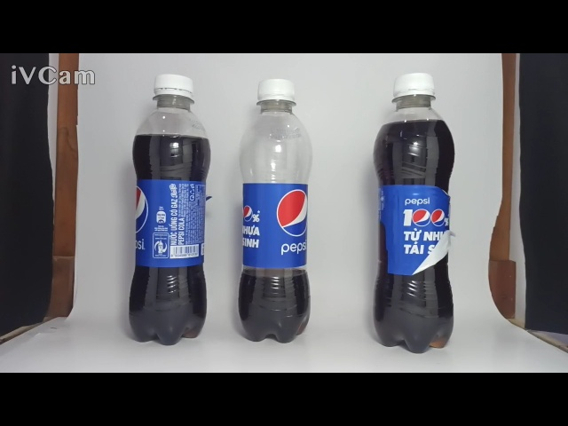
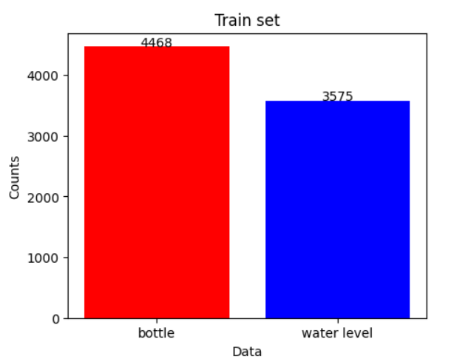
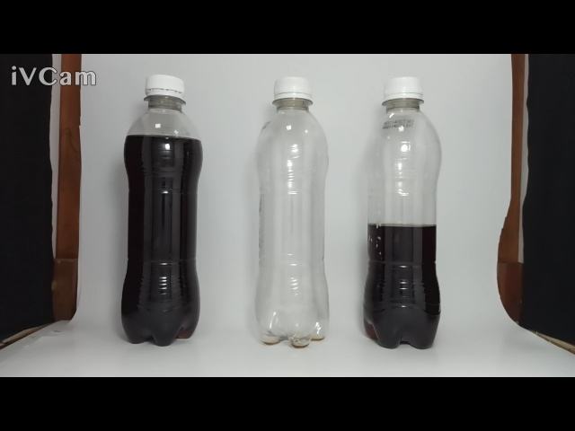
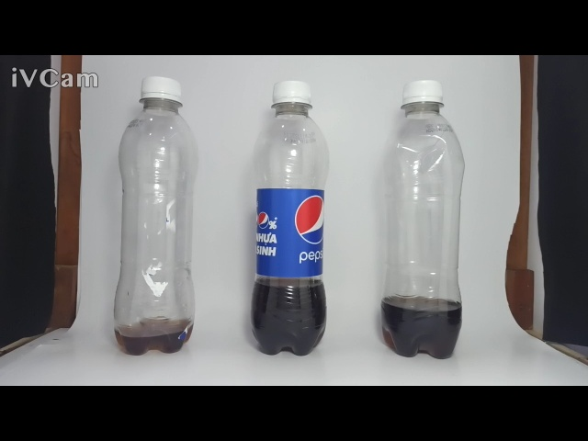
3.1.a DATA COLLECTION
STAGE 1
DETECT MODEL: YOLOv8 MODEL
0
bottle
1
Water level

Slide 18
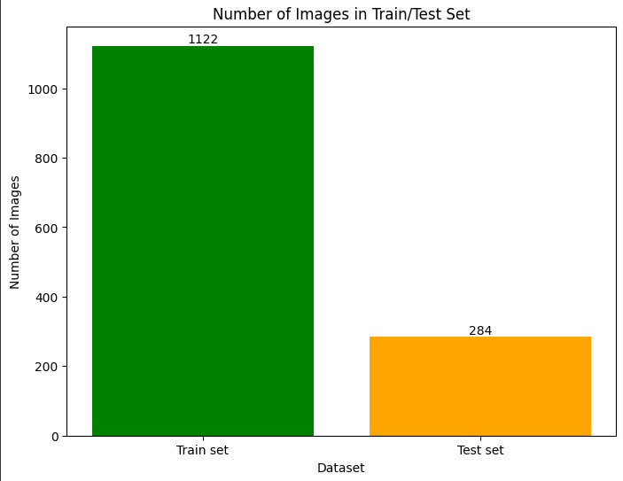
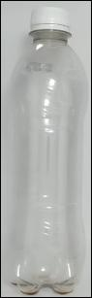
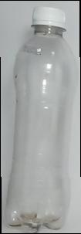
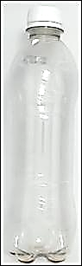
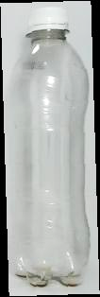
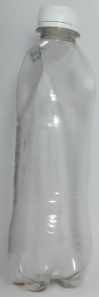
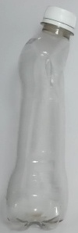
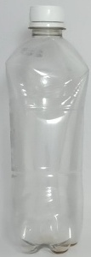
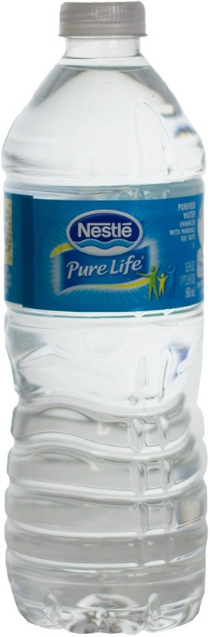
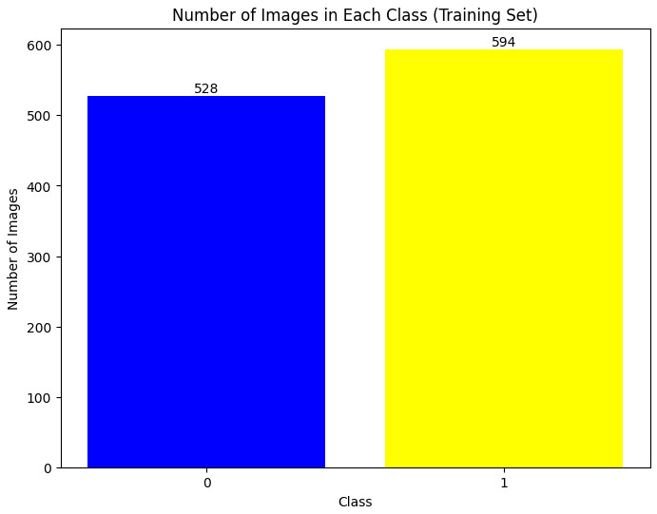
3.1.a DATA COLLECTION
STAGE 1
MODULE 1: BOTTLE CHECK – CNN MODEL
0: Good
…
1: Error
…
The set of defective water bottle photos includes photos of water bottles with distorted or punctured shapes and photos of water bottles with other shapes belonging to other brands.

Slide 19
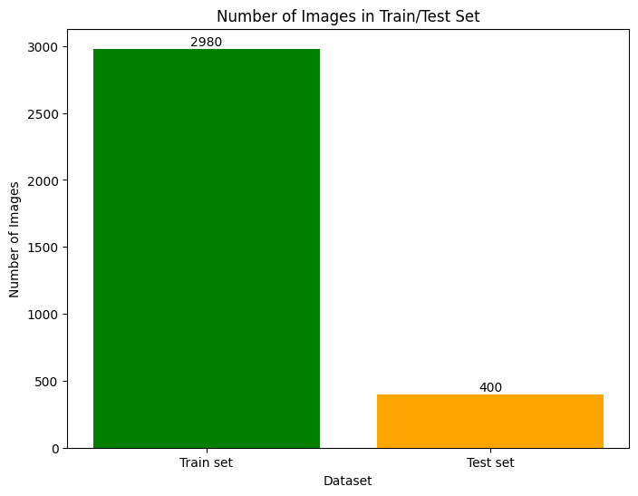
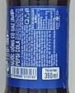
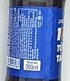
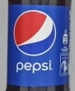
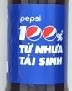
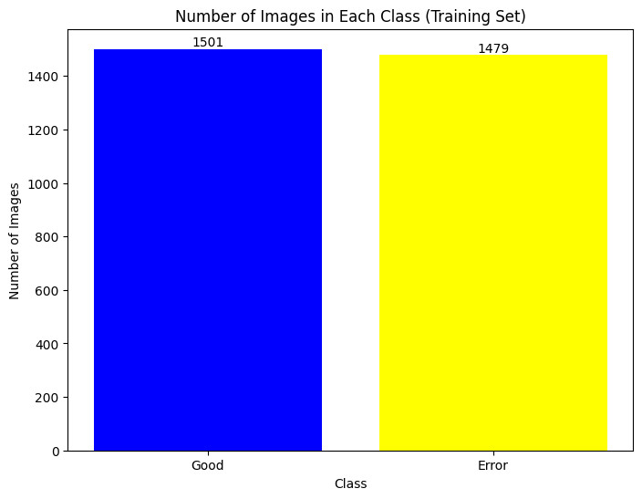
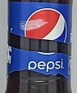
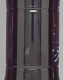
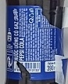
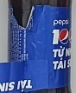
3.1.a DATA COLLECTION
STAGE 1
MODULE 3: LABEL CHECK – CNN MODEL
0: Good
…
1: Error
…
In the set of error label images, there are images of torn labels, labels stained by dye, loss of details, and water bottle areas without labels.

Slide 20

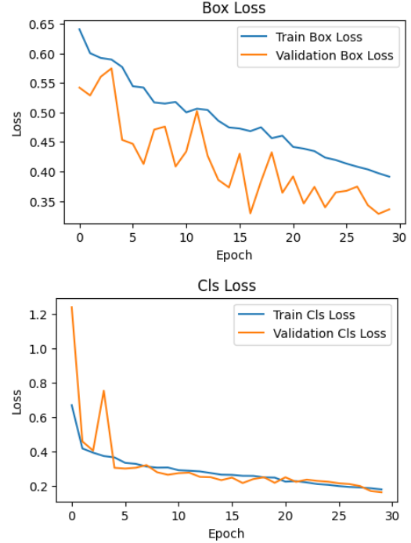
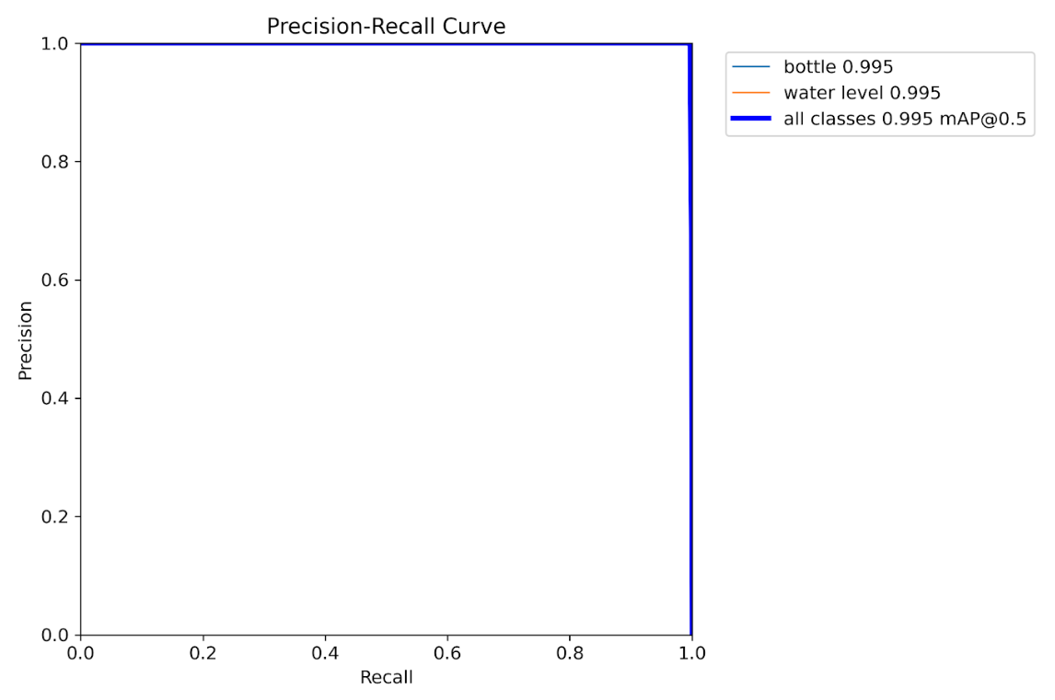
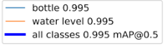

3.1.b MODEL - TRAINING – EVALUATION
STAGE 1
DETECT MODEL: YOLOv8 MODEL
Load pretrain model: yolov8m
Epoch: 30
Image size: 640x480
➔ With IOU threshold = 0.5 considered to be an accurate result, mAP is high, and the model's loss is gradually decreasing and very low, the results show that we have a model that works quite well.

Slide 21
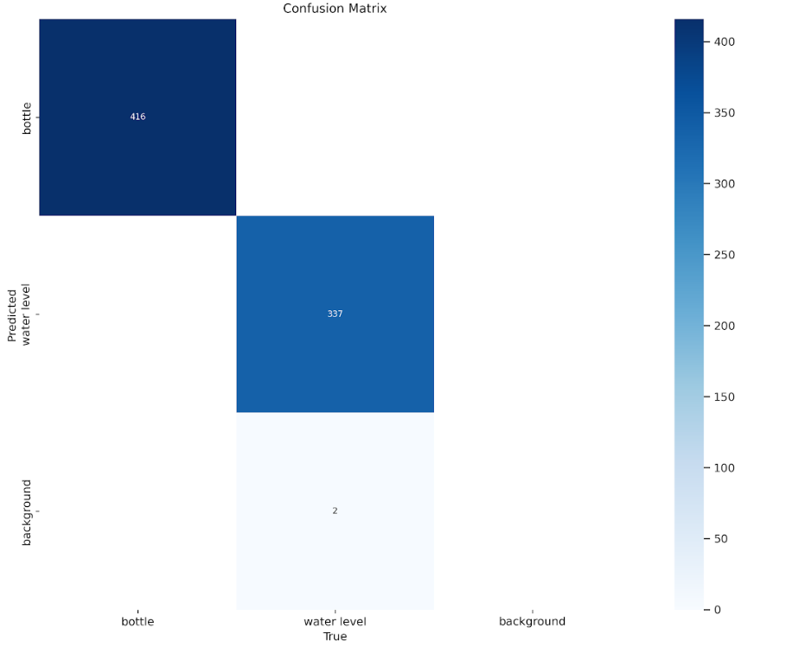
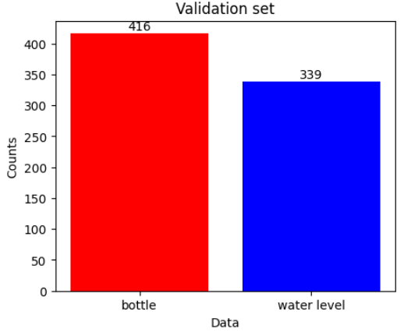

3.1.b MODEL - TRAINING – EVALUATION
STAGE 1
DETECT MODEL: YOLOv8 MODEL

Slide 22
3.1.b MODEL - TRAINING – EVALUATION
STAGE 1
MODULE 1: BOTTLE CHECK – CNN MODEL
 |  | CNN (Custom) | VGG16 | VGG19 | ResNet18
Recall | Good | 0.97 | 1 | 1 | 0.94
 | Error | 0.99 | 0.94 | 0.99 | 0.97
Precision | Good | 0.96 | 0.84 | 0.96 | 0.92
 | Error | 0.99 | 1 | 1 | 0.98
Accuracy (test set) |  | 0.98 | 0.95 | 0.99 | 0.96
Average speed (1/100 image) |  | 103.8 ms | 75.7 ms | 78.1 ms | 71.9 ms
Parameters |  | 79.905.560 | 19.041.346 | 24.351.042 | 11.188.354

Slide 23
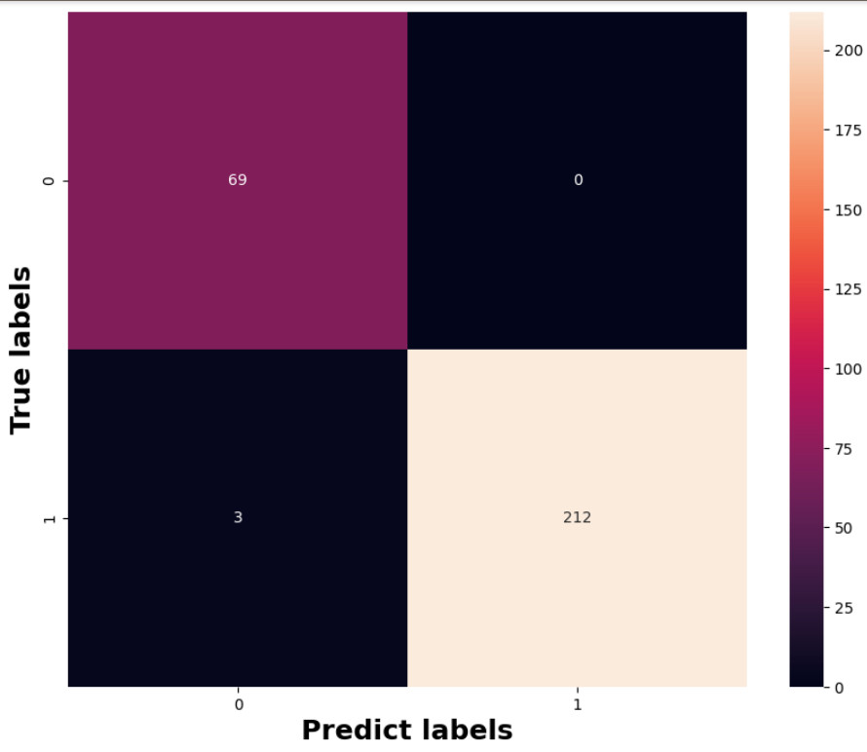
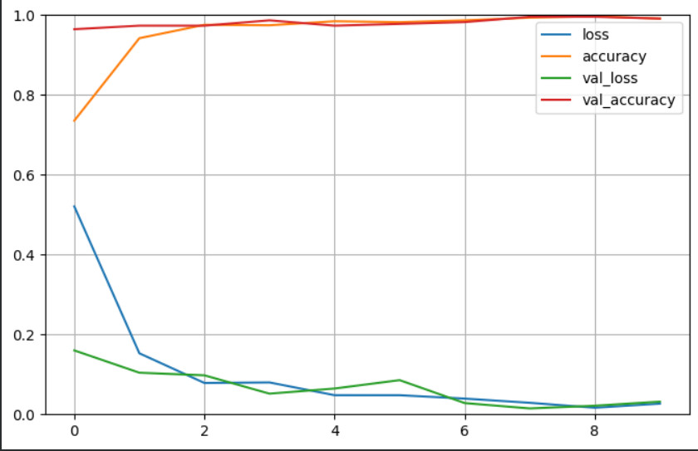
3.1.b MODEL - TRAINING – EVALUATION
STAGE 1
MODULE 1: BOTTLE CHECK – CNN MODEL
0: Good
1: Error
Predict: Test set
Model: VGG19

Slide 24
3.1.b MODEL - TRAINING – EVALUATION
STAGE 1
MODULE 3: LABEL CHECK – CNN MODEL
 |  | CNN (Custom) | VGG16 | VGG19 | ResNet18 | ResNet34
Recall | Good | 0.87 | 1.00 | 0.96 | 0.96 | 0.97
 | Error | 0.97 | 0.93 | 0.96 | 0.96 | 0.96
Precision | Good | 0.97 | 0.93 | 0.96 | 0.96 | 0.96
 | Error | 0.88 | 1.00 | 0.96 | 0.96 | 0.98
Accuracy (test set) |  | 92% | 95.5% | 96% | 96% | 96.75%
Average speed (1/100 image) |  | 90.71 ms | 83.42 ms | 85.77 ms | 64.46 ms | 78.77 ms
Parameters |  | 23.760.162 | 15.766.850 | 21.076.546 | 12.600.450 | 23.290.178

Slide 25
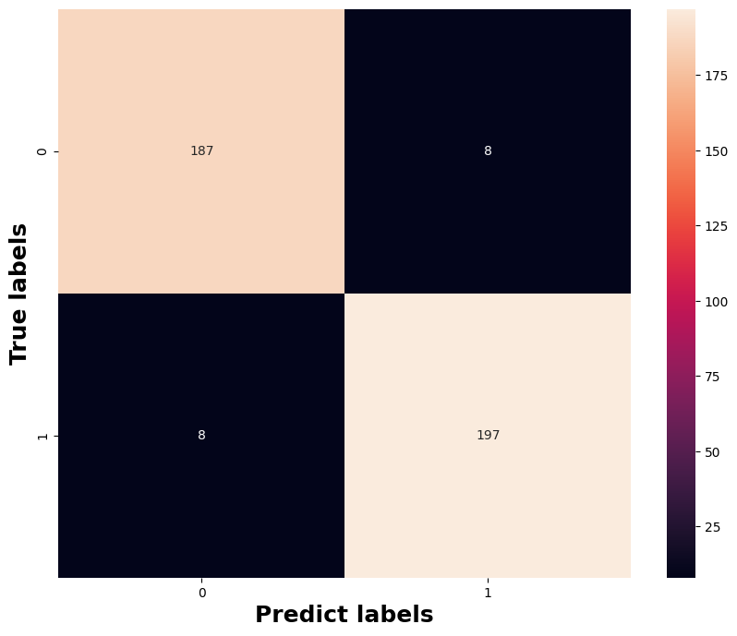
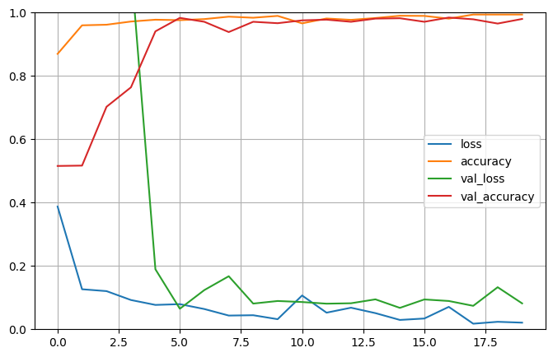

3.1.b MODEL - TRAINING – EVALUATION
STAGE 1
MODULE 3: LABEL CHECK – CNN MODEL
0: Good
1: Error
Predict: Test set
Model: Resnet 18

Slide 26
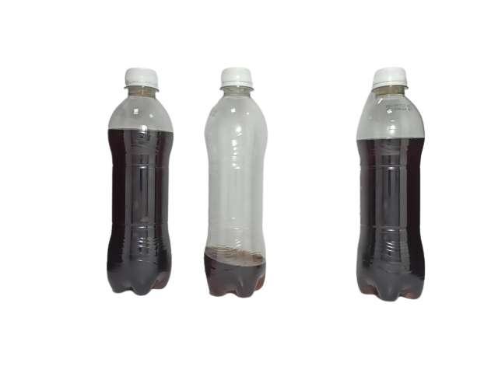
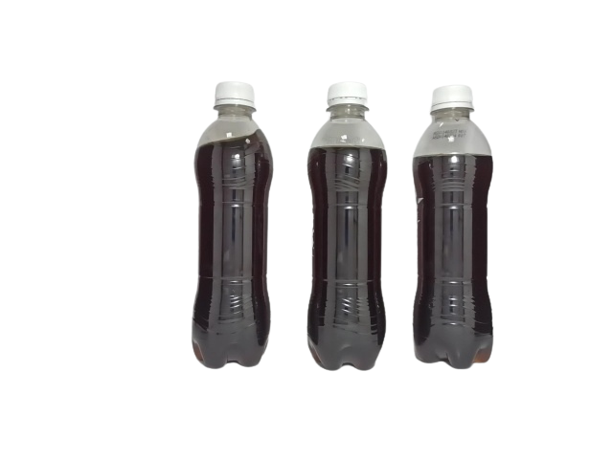
3.1.b MODEL - TRAINING – EVALUATION
STAGE 1
MODULE 2: WATER LEVEL CHECK
Test set
Number of bottles | Accuracy
100 | 96%
The accuracy is quite high, but there are still objects that are misjudged because the water level fluctuates too much.
Water level
Bottle
Detects 2 objects: bottle and water level.
Filter out water level objects that do not intersect with the bottle.
Assign the same id to both bottle and water level.
Calculate the height ratio, compare it with the predetermined ratio (calculated on products that are considered good).
Actual: GOOD
Predict : ERROR

Slide 27
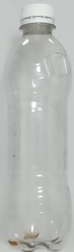
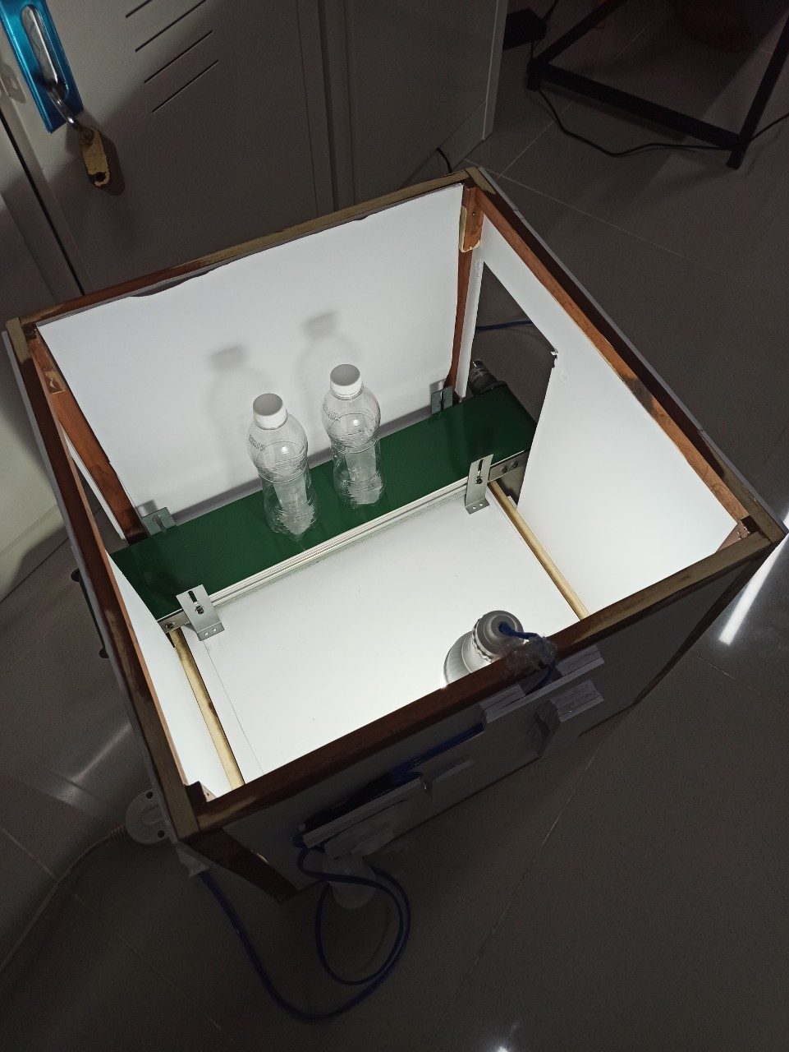
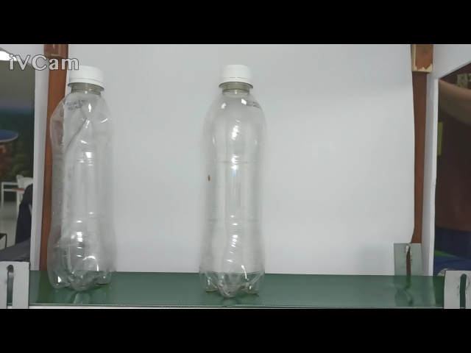
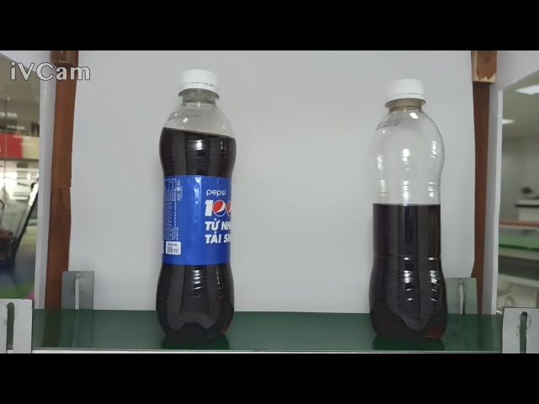
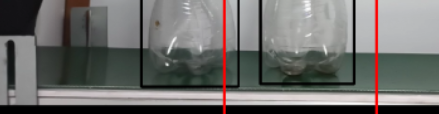
3.1.c PROBLEMS
STAGE 1
Deploy the system onto previously prepared hardware and add a conveyor belt.
➔ The results were very bad.
In most cases of punctured bottles, the model cannot solve them.
Error
Error
Operating well
Operating poorly
The box of the water bottle was found to be very misaligned.
➔ Having problems with detection model and bottle shape classification.

Slide 28
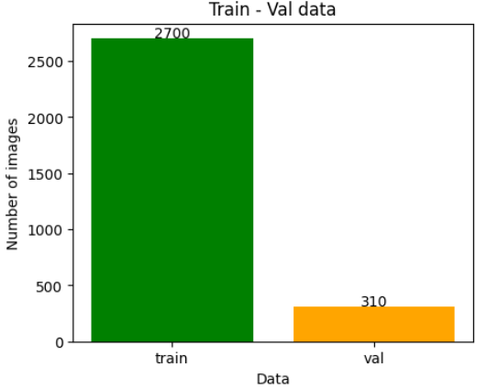


3.2.a DATA COLLECTION
STAGE 2
DETECT MODEL: YOLOv8 MODEL
Collect more data from new hardware.
The labeling method remains the same.
0
bottle
1
Water level

Slide 29






3.2.a DATA COLLECTION
STAGE 2
MODULE 1: BOTTLE CHECK – CNN MODEL
New data
0: Good
…
1: Error
…
Collect more data from new hardware, collect more images of punctured water bottles.

Slide 30



3.2.b MODEL - TRAINING – EVALUATION
STAGE 2
DETECT MODEL: YOLOv8 MODEL
Load pretrain model: yolov8m
Epoch: 30
Image size: 640x480
➔ The results are similar to the detect model trained in stage 1, it is quite good.

Slide 31


3.2.b MODEL - TRAINING – EVALUATION
STAGE 2
DETECT MODEL: YOLOv8 MODEL

Slide 32
3.2.b MODEL - TRAINING – EVALUATION
STAGE 2
MODULE 1: BOTTLE CHECK – CNN MODEL
 |  | CNN (Custom) | VGG16 | VGG19 | ResNet18
Recall | Good | 0.99 | 1 | 1 | 0.98
 | Error | 0.97 | 1 | 0.99 | 0.97
Precision | Good | 0.93 | 0.99 | 0.97 | 0.92
 | Error | 1 | 1 | 1 | 0.99
Accuracy (test set) |  | 0.98 | 0.99 | 0.99 | 0.97
Average speed (1/100 image) |  | 108.74 ms | 75.7 ms | 79.82 ms | 71.9 ms
Parameters |  | 79.905.560 | 19.041.346 | 24.351.042 | 11.188.354

Slide 33


3.2.b MODEL - TRAINING – EVALUATION
STAGE 2
MODULE 1: BOTTLE CHECK – CNN MODEL
0: Good
1: Error
Predict: Test set
Model: VGG19

Slide 34


3.3.c PROBLEMS
STAGE 2
The case of the water bottle error due to puncture has been fixed, but the accuracy is still not high.
Processing speed per frame is very slow.
Run 3 camera

Slide 35





4 OPTIMIZER
CNN model
module 1, module 3
Convert
CNN model – module 1
Type | TensorFlow | TensorRT
Inference speed (100 images) (s) | 7.3531 | 0.2537
Accuracy (%) | 96 | 96
CNN model – module 3
Type | TensorFlow | TensorRT
Inference speed (100 images) (s) | 7.6927 | 0.1797
Accuracy (%) | 94 | 94
Improved speed

Slide 36

2.7 DEMONSTRATION

Slide 37
III. CONCLUSION

Slide 38



CONCLUSION
The product works quite well, meeting real-time requirements and checking product quality on the production line.
But with the current product, there are still many unresolved problems, but we can solve them in the future:
The output results of model classification are absolutely stable.
Faster processing speed.
Check exactly where the error is located by using anomaly detection methods.
Anomaly detection

Slide 39
THANK YOU
FOR WATCHING

